Slide 1


Robotics
Human-Robot Interaction
Team: Casey Chen, Hailey Dhanens, Matthew Harker,
Angie Quach, & Derek Vaughan
Client: Dr. Szilárd Vajda
Supervisor: Dr. Donald Davendra
November 29, 2018

Slide 2
Table of Contents
Project Introduction
Requirements Checklist
Requirements Analysis
Structural Design
Development Tools
Test Scenarios
Project Schedule
Conclusions

Slide 3

Our Project:
Team Roles:
1
Showcase meaningful human-robot interaction using the Aldebaran NAO robots acquired by CWU.
Project Manager: Angie Quach
Coding Lead: Casey Chen
QA/Testing Lead: Matthew Harker
Documentation Lead: Derek Vaughan
Communication Lead: Hailey Dhanens

Slide 4
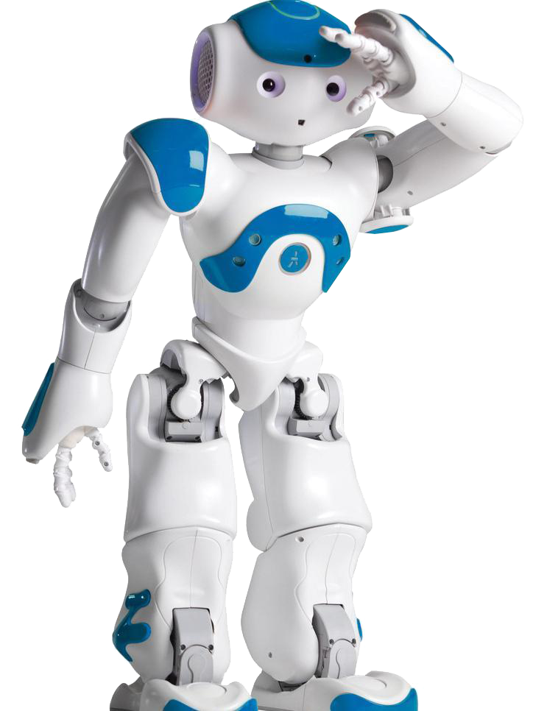
What is NAO?
2
Fully programmable
Can walk, talk, listen for commands
Many onboard sensors

Slide 5

3
Requirements

Slide 6
Requirements Checklist - High Priority
4
The NAO unit should be able to...
Quickly recognize and act upon basic commands and gestures
Quickly answer all questions (from a finite list)
Move each appendage when reacting

Slide 7
Requirements Checklist - Low Priority
5
We would like the NAO unit to be able to...
Exhibit emotional response based on user’s emotion.
Recognize “foul” language
Listen for music and perform a dance

Slide 8

6
Requirements
Analysis

Slide 9
Requirements Analysis - Validity
7
Ensure requirements are relevant towards project goals:
Commands & gestures displays ability to interpret
language and perform corresponding tasks.
Reacting to verbal emotions will enhance the user’s
experience.
Our software’s requirements are valid.

Slide 10
Requirements Analysis - Consistency
8
Ensure requirements show no conflicts of consistency:
Choregraphe is capable of utilizing all required tools
Also allows safe & easy testing.
NAO can take on various “states”
Allows functions to concurrently exist in memory
and be acted upon when prompted.
Our software’s requirements are consistent.

Slide 11
Requirements Analysis - Feasibility
9
Ensure requirements are feasible in the timeframe:
We have the necessary experience.
NAO’s API allows quick development.
Some suggested functionalities had to be cut:
American Sign Language (ASL).
Still researching facial detection capabilities.
Our software’s requirements are feasible.

Slide 12

10
Structural Design

Slide 13
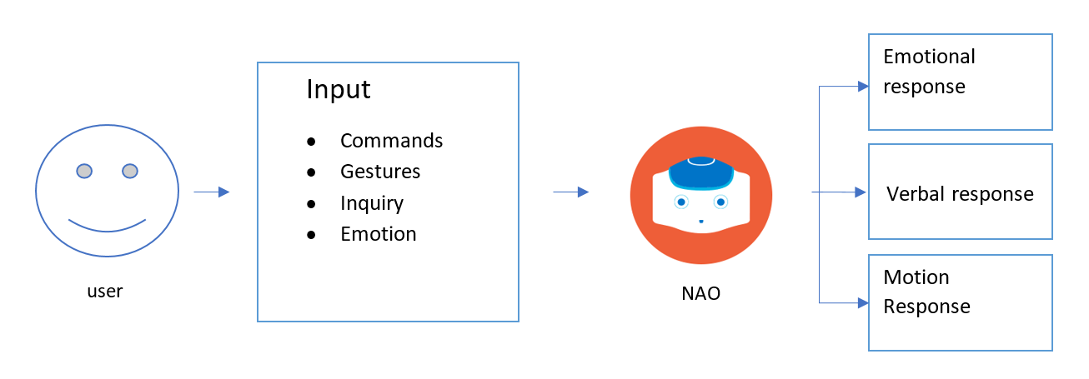
Structural Design - High Level
11

Slide 14
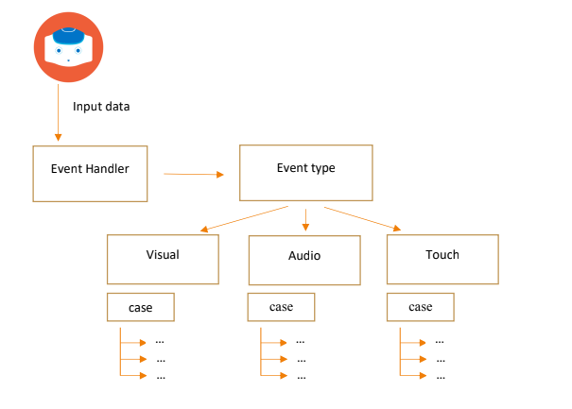
Structural Design - Low Level
12

Slide 15

13
Tools & Strategies

Slide 16

Development Tools & Technologies
14
NAO Robot
NAOqi Framework
Choregraphe Software Development Kit (SDK)
Python
Various web-based API’s

Slide 17

Test Scenarios
15
Test users could be...
Computer science students
Computer science staff & faculty
General university population
Prospective CWU students or employees

Slide 18
Test Scenarios
16
Have test user...
Read through small user manual (one page)
Say “hello” to NAO
Perform any desired commands from user manual
Exhibit emotion when giving commands (e.g., shouting)
Attempt to give a confusing command to NAO

Slide 19

Development Methodology
17
Agile Scrum methodology
Team divided into groups
Weekly meetings for testing and discussion

Slide 20
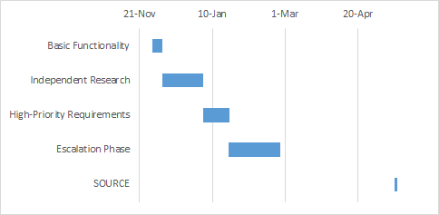
Project Schedule (Gantt Chart)
18
~1-2 week rushes for each module:
a

Slide 21

Conclusions
19
Who are we?
What are we doing?
Why are we doing it?
How will we accomplish this?
When will it be done by?
Audience Questions?

